Slide 1
MACOM Diode Products - HMICTM rev 2
Joe Bukowski, Rick Cory
17 March 2017

Slide 2
Product Families
PIN/NIP Diodes:
Switching
Attenuation
Limiting
Varactor Diodes:
Tuning
Phase Shifting
Schottky Diodes:
Detection
Frequency Mixing
Diode Products
Attenuators
Multiplier Diodes:
Frequency Multiplication
Waveshaping
Passive Devices
RF Chokes/Inductors
MNS Capacitors
Resistors

Slide 3




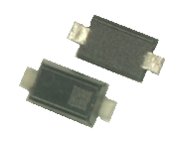
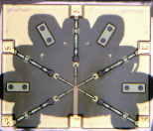
Product Configurations
Discrete Device
Beam Lead/ Flip Chip
(to 70+ GHz)
HMIC Discrete Surmount
(to 26.5GHz)
Plastic
(to 6 GHz)
Integrated Solutions

Slide 4
HMICTM Process
PIN Diode Circuits Schottky Diode Circuits
Passive Networks

Slide 5
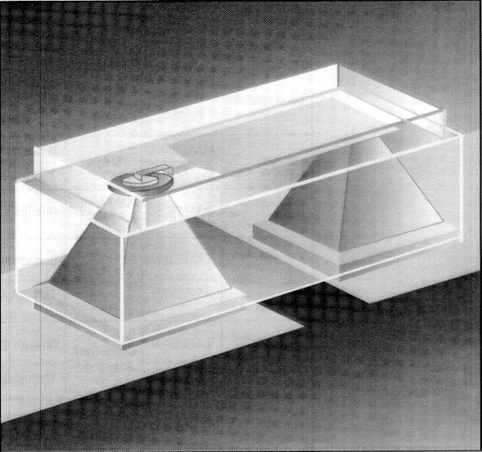
HMICTM = Heterolithic Microwave Integrated Circuit
The HMICTM process comprises pedestals of Si embedded in borosilicate glass
The Si pedestals may form
PIN diodes
Schottky diodes
electrical vias
thermal vias
The glass features
low relative dielectric constant (ε_{r} = 4.1)
very low loss tangent
thermal coefficient of expansion well matched to that of Si (TCE_{Si} ≈ 3.0 ppm/°C, TCE_{glass} ≈ 3.3 ppm/°C
HMIC Surmount Diode

Slide 6
Simplified HMICTM Process
Start with Si wafer approximately 20 - 25 mils thick
Use photolithography to mask regions of wafer where diodes or vias will be formed
Etch Si in unmasked areas to depth greater than that of final wafer thickness
“Sandwich” glass wafer on top of etched Si wafer and melt glass so it slumps into etched depressions
Cool glass/Si wafer and remove excess glass from top side of wafer to expose tops of Si pedestals
“Wet-Etched” Si Wafer
“Dry-Etched” Si Wafer

Slide 7
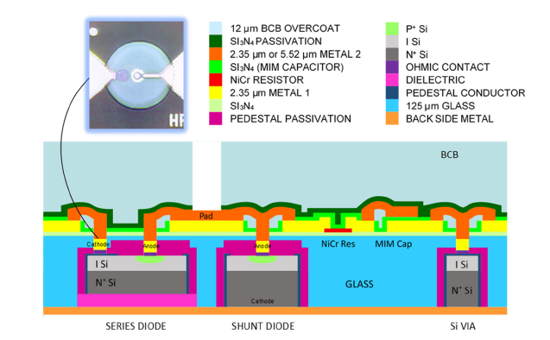
Simplified HMICTM Process (cont’d)
Form diode junctions in tops of Si pedestals
Metalize top surface of glass/Si wafer to
interconnect diodes
form passive structures (spiral inductors, capacitors, resistors, transformers, etc.)
Grind back side of wafer to expose underside of glass and Si pedestals
Metalize back side of wafer
Apply benzocyclobutene (BCB) layer to top side for scratch protection
Dice wafer

Slide 8
HMICTM Cross Section
SPIRAL +
SERIES PIN
SHUNT PIN DIODE
THERMAL VIA WITH
VIA TO GROUND
DIODE
WITH CATHODE BIAS
PASSIVE ELEMENTS
I Si
N+ Si
N+ Phos
P+ Si
Si3N4
NiCr
polyimide/ poly-Si
Metal
Glass
SiO2

Slide 9
High Frequency Capacitors
Purpose
Tuning elements
Block DC voltages
Metal-Nitride-Metal
Two layers of metal
Air bridge over dielectric edge
Q >> 100 @ 2.0 GHz
Interdigitated
Air dielectric
Low breakdown voltages
Small capacitance values
Single layer of metal
Microstrip Line Stub
Unterminated (Open)
<1/4 λ at frequency
Very large at low frequencies
Air Bridge
Terminal 2
PECVD
Nitride
Dielectric
HMIC Glass
Substrate
Terminal 1
Terminal 2
Air
Dielectric
Terminal 1
Stub
< 1/4 λ
Microstrip Line

Slide 10
High Frequency Inductors
Metal Lines
Enhanced mutual inductance between segments
Parasitic capacitance to ground
Spiral
Round - higher Q
Square - max inductance
Two layer, air bridge metal
Q ≈ 42 @ 2.0 GHz
Serpentine
Single level metal
Low inductive values
Higher frequency applications
Inductor Underpass
Dielectric
Very Low
Parasitic
Capacitance
Air
Bridge
HMIC Glass
Backside Ground Plane
Mutual
Coupling

Slide 11
Resistors
Deposited Thin Film Metal
Thin film metals
UHVCVD Polysilicon
Typical properties:
Interconnect
Metallization
HMIC Glass
Metal Ground Plane
Material | Sheet Resistivity | Temperature Coefficient of Resistance
 | (Ω/) | (ppm/°C)
NiCr | 5 - 100 | 20
UHVCVD Polysilicon | 10k – 100k | __

Slide 12
Transmission Lines
Electric
Field
Lines
Metal Conductor
Distributed inductors
Provides specific impedance
Microstrip
Conductor width
Substrate thickness
Substrate dielectric constant
Coplanar
Conductor with adjacent lateral ground planes
Width & thickness of center conductor
Spacing to ground planes
Substrate dielectric Constant
Area inefficient
Metal Ground Plane
HMIC Glass
Metal
Ground
Plane
Metal Center
Conductor
Metal
Ground
Plane
Electric
Field
Lines
HMIC Glass

Slide 13
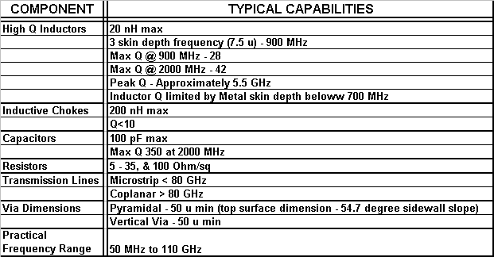
Typical HMICTM Component Capabilities

Slide 14
HMICTM PIN Diode Products
Switching

Slide 15
PIN Diodes
PIN Diodes are current-controlled RF resistors
Primarily used in control circuits
Switches
Attenuators
Limiters
HMICTM PIN diodes are made from Si

Slide 16
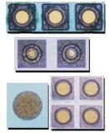
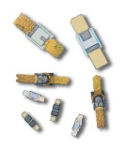

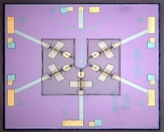
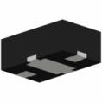
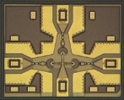

PIN Diode Families
Si Discrete | Si HMIC™ | GaAs | AlGaAs
Wide operating frequency range, to 20 GHz Excellent power handling PIN and NIP diodes available I layer: 2 – 300 µm Available as: Unpackaged chips SMT packages Ceramic Packages Beam leads | Very Wide operating frequency range, to 30 GHz I layer: 8 – 100 µm Available as Single junction devices Multiple junction ICs Wire-bondable or solderable | Wide operating frequency range, to 30 GHz Good power handling Available as: Unpackaged chips SMT packages Ceramic Packages Beam leads | Extremely Wide operating frequency range, to 100 GHz Lower insertion loss than comparable Si or GaAs switches I layer: 3 µm Available as Multiple junction ICs Wire-bondable

Slide 17
HMICTM Discrete Diode Solution
Surmount PIN diodes
Available I-region Thickness: 7 to 100 µm
Part Number | Size (mils) | VB (V) | 1 MHz | 100 MHz |  |  | 1 GHz |  |  |  |  | Lifetime (ns) | Nominal I-region (μm)
 |  |  | Cj 40 V (pF) | Rs 10 mA (Ω) | Rs 20 mA (Ω) | Rs 100 mA (Ω) | Cj 40 V (pF) | Rs 10 mA (Ω) | Rs 20 mA (Ω) | Rs 50 mA (Ω) | Rs 70 mA (Ω)
MADP-042305 | 22 X 41 | 80 | 0.13 |  |  |  | 0.14 |  | 1.32 | 1.18 |  | 180 | 7
MADP-042405 | 22 X 41 | 80 | 0.57 |  |  |  | 0.58 |  | 0.62 | 0.58 |  | 255 | 7
MADP-042505 | 22 X 41 | 80 | 0.27 |  |  |  | 0.27 |  | 0.83 | 0.76 |  | 210 | 7
MADP-042905 | 22 X 41 | 80 | 0.06 |  |  |  | 0.06 |  | 3.14 | 2.6 |  | 140 | 7
MA4SPS302 | 23 X 55 | 70 | 0.40 | 1 |  |  | 0.30 | 1.3 |  |  |  | 460 | 10
MA4SPS402 | 20 X 49 | 70 | 0.034 | 4.6 |  |  | 0.04 | 5 |  |  |  | 200 | 10
MADP-017015-1314 | 60 X 30 | 115 | 0.32 |  |  |  | 0.31 | 0.72 |  |  | 0.51 | 1300 | 15
MADP-030015-1314 | 60 X 30 | 115 | 0.79 |  |  |  | 0.78 | 0.49 |  |  | 0.38 | 1600 | 15
MADP-017025-1314 | 60 X 30 | 135 | 0.23 |  |  |  | 0.23 | 1.01 |  |  | 0.64 | 2300 | 25
MADP-030025-1314 | 60 X 30 | 135 | 0.50 |  |  |  | 0.50 | 0.65 |  |  | 0.45 | 2800 | 25
MA4SPS502 | 23 X 57 | 200 | 0.14 |  | 2.4 | 1.4 | 0.09 |  |  |  |  | 2800 | 50
MA4SPS552 | 12 X 22 | 200 | 0.08 |  | 2.4 | 1.7 | 0.06 |  |  |  |  | 2500 | 50
MA4SPS421 | 20 X 41 | 200 | 0.09 |  |  |  | 0.07 | 6.2 |  |  |  | 5000 | 100
MA4SPS422 | 20 X 41 | 200 | 0.18 |  |  |  | 0.13 | 3.1 |  |  |  | 10000 | 100
MADP-042308-1306 | 20 X 41 | 100 | 0.20 |  |  |  | 0.10 |  | 1.38 | 1.18 |  | 280 | 10
MADP-042408-1306 | 20 X 41 | 100 | 0.50 |  |  |  | 0.37 |  | 0.67 | 0.61 |  | 380 | 10
MADP-042508-1306 | 20 X 41 | 100 | 0.30 |  |  |  | 0.18 |  | 0.97 | 0.87 |  | 310 | 10
MADP-042908-1306 | 20 X 41 | 100 | 0.15 |  |  |  | 0.05 |  | 3.63 | 3.02 |  | 230 | 10

Slide 18
PIN Switches
Modules Single-Chip

Slide 19
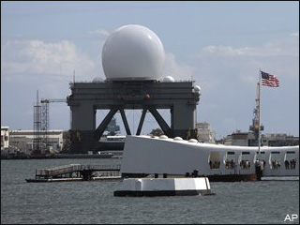
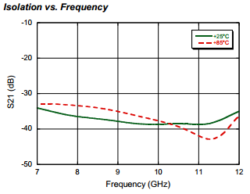
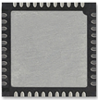
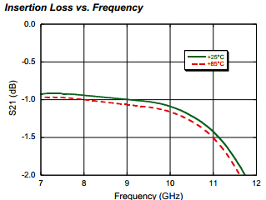
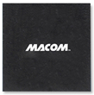
X-Band Terminated SPDT Switch MASW-011071
Low Insertion Loss: 1 dB
High Isolation: 38 dB
Integrated Bias Network and Termination Circuit
Greater than 20 W CW Power Handling @ 70 °C
Lead (Pb)-Free 7 x 7 mm 44-lead PQFN Package
Missile Defense, Weather Radar Systems

Slide 20
HMIC™ Si PIN Switches: 2 W, DC – 26 GHz
Products
MASW-001100-11900W (SPST)
MASW002100-11910W (SPDT)
MASW-003100-19220W (SP3T)
MASW-004100-11930W (SP4T)
MASW-005100-11940W (SP5T)
Features
Operating Frequency
50 MHz – 30 GHz
Series-Shunt Configuration
High Isolation: >35 dB
Low Loss: <1.0 dB Insertion Loss
Switching Time: 50 ns
Max RF Incident Power:
>6.0 W CW @ 2 GHz
2.0 W CW @ 22 GHz
RoHS Compliant
SP5T
SP3T w/ Integrated Bias Network
Notes:
20

Slide 21
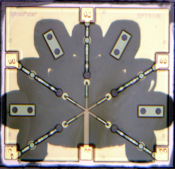
HMICTM Wire-Bondable Switches
Features
SPST through SP6T
Broadband Performance to 26 GHz
Wire /Ribbon Bond Connections
Available With or Without Integrated Bias Networks
SP3T with Bias Network
SP5T without Bias Network

Slide 22
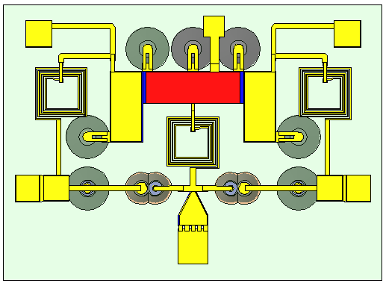
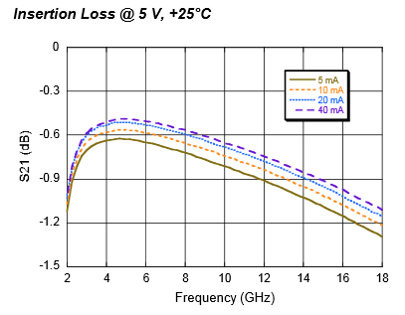
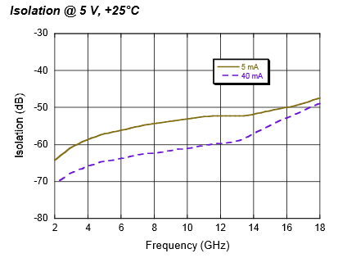
HMICTM SP2T High Current MASW-011052
Broad Bandwidth: Specified up to 18 GHz, Usable up to 26 GHz
Integrated Bias Network: High Bias Current +/- 60 mA
Low Insertion Loss/High Isolation
Glass Encapsulation Construction
RoHS Compliant and 260 °C Reflow Compatible

Slide 23
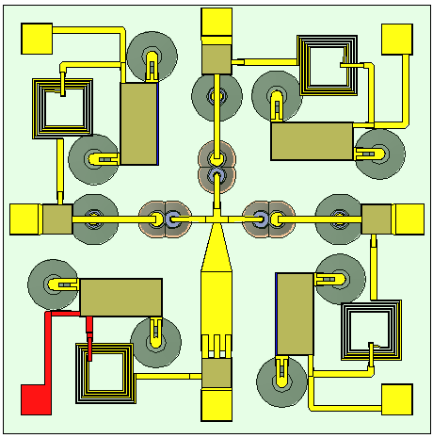
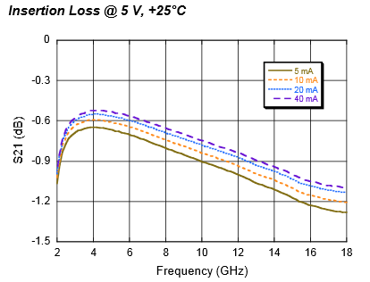
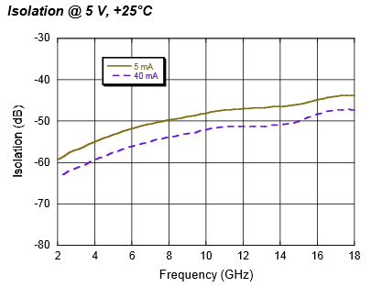
HMICTM SP3T High Current MASW-011053
Broad Bandwidth: Specified up to 18 GHz, Usable up to 26 GHz
Integrated Bias Network: High Bias Current +/- 60 mA
Low Insertion Loss/High Isolation
Glass Encapsulation Construction
RoHS Compliant and 260 °C Reflow Compatible

Slide 24
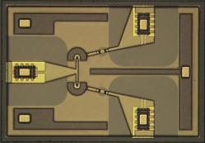
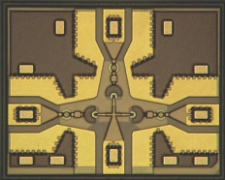
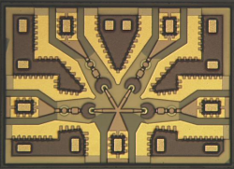
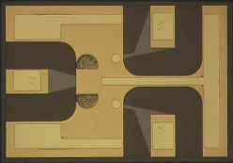
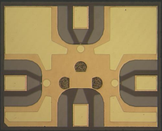
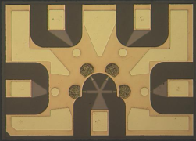
HMICTM Package-less Surface Mountable Si PIN Diode Switches
Surface mount - No wirebonds
Packageless - Low parasitics
Series/Shunt multi-throw designs
High Power - 6 W incident
Topology | Frequency | Insertion Loss (dB) | Isolation (dB) | P_{0.1dB} (dBm) | Part Number
SPDT | 6 GHz 13 GHz 20 GHz | 0.6 0.9 1.2 | 45 31 25 | 36 | MASW-002103-1363
SP3T | 6 GHz 13 GHz 20 GHz | 0.65 0.95 1.25 | 37 28 22 | 36 | MASW-003103-1364
SP4T | 6 GHz 13 GHz 20 GHz | 0.7 1.0 1.3 | 35 30 26 | 36 | MASW-004103-1365

Slide 25
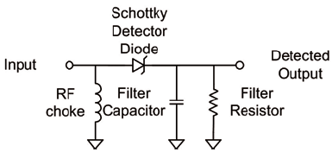
Schottky Diodes
Frequency Mixing Detection

Slide 26
HMICTM Discrete Schottky Diodes
Features
Surmount Single-Junction Si Schottky diodes
Low, Medium and High Barrier Heights Available
Frequency Range: DC – 30 GHz
Very Low Series Resistance
Very Low Junction Capacitance
Solderable – No Wire Bonds Required
Applications
Mixers and Detectors
Receiver Protector Limiters

Slide 27
HMICTM Mixer Advantages
Passive, Double Balanced
Silicon Schottky Barrier Diode Ring Quad
Internal Matching at All Ports
Good Port to Port Isolation
Low LO Drive
High IP₃ Performance
Small Size
SOT25 Package
NO EXTERNAL COMPONENTS Needed
Monolithically Integrate Low Loss Passives
mmW Frequency Capability
Smaller
Lower Cost
Schottky Diodes NOT Frequency Limited Below 30 GHz

Slide 28
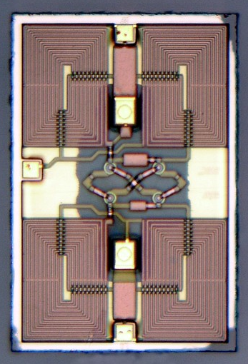
HMICTM Mixers
Narrowband, Planar, Balun, Low Loss Transformers
Silicon Schottky Barrier Diode Xover Ring Quad
Low, Medium, & High Barrier Height Diodes
Internally Matched
Good port to port Isolation
Passive Double Balanced Mixer
Low LO drive
High IP₃ Performance
Small Size
SOT25 Packaging
IF
RF
LO

Slide 29
Flip Chip Diodes
PIN

Slide 30
Solderable HMIC™ Flip Chip PIN Diodes
Ultra Low Capacitance
Millimeter Wave Switching & Cutoff Frequency
Silicon Nitride Passivation
Polyimide Scratch Protection
Cu/Ni/Au Solderable Terminals
RoHS Compliant
PIN Diodes - Switching
Parameter | Units | MA4FCP200
Frequency | GHz | Up to 30
Capacitance @ 40 V | pF | 0.020 typical
Series Resistance | Ω | 2.8 typical
Breakdown Voltage | V | 70 min
Size | µm | 381 X 230
Parameter | Units | MA4FCP300
Frequency | GHz | Up to 30
Capacitance @ 40 V | pF | 0.080 typical
Series Resistance | Ω | 2.6 typical
Breakdown Voltage | V | 70 min
Size | µm | 733 X 393
Parameter | Units | MA4FCP300
Frequency | GHz | Up to 30
Capacitance @ 10 V | pF | 0.050 typical
Series Resistance | Ω | 2.1 typical
Breakdown Voltage | V | 40 min
Size | µm | 733 X 393

Slide 31
Passive Devices
HMIC™ Bias Networks
Attenuators
MNS Capacitors Spiral Inductors Resistor Networks

Slide 32
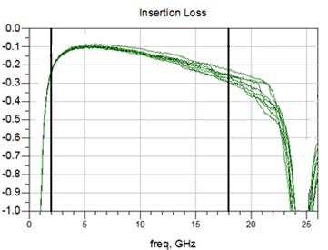
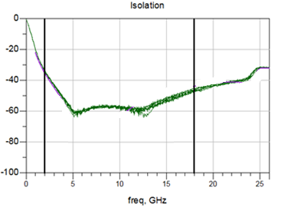
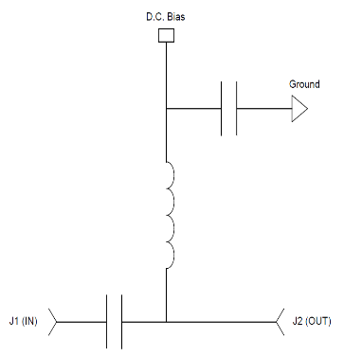
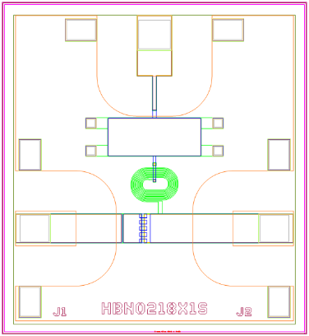
MABT-011000 2-18 GHz HMICTM Surmount Bias Network
HMIC™ Surmount Technology
Broadband Performance 2 – 18 GHz
Parameter | Frequency (GHz) | Target Min | Target Avg | Target Max
Insertion Loss | 2 | - | 0.1 | 0.50
 | 6
 | 12
 | 18
RF – DC Isolation | 2 | 30 | 35 | -
 | 6
 | 12
 | 18
Input Return Loss | 2 | 15 | 17 | -
 | 6
 | 12
 | 18
Output Return Loss | 2 | 15 | 17 | -
 | 6
 | 12
 | 18
High current ±60mA; Voltage ±50V

Slide 33
Thank You

Slide 34
Appendix

Slide 35
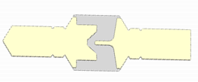
Si Mesa Beamlead PIN Diodes
Rugged Silicon-Glass Construction
Silicon Nitride Passivation
Low Parasitic Capacitance and Inductance

Slide 36
Si Planar Beamlead PIN Diodes
Rugged Silicon-Glass Construction
Silicon Nitride Passivation
Low Parasitic Capacitance and Inductance

Slide 37
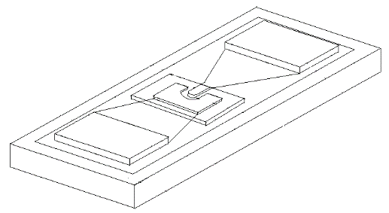
Flip Chip Products
Low Capacitance Devices
PIN Diodes | Configuration | Max Frequency | Breakdown Voltage Vb | Ct Max | Rs Typical | Material
 |  | (GHz) | (V) | (pf) | (Ω)
MA4GP907 | Single | 40 | 45 | 0.025 | 4.2 | GaAs
MA4AGP907 | Single | 50 | 50 | 0.020 | 4.2 | AlGaAs
MA4FCP200 | Single | 40 | 50 | 0.015 | 2.8 | HMIC
MA4FCP300 | Single | 30 | 70 | 0.025 | 2.6 | HMIC
MA4FCP305 | Single | 18 | 40 | 0.050 | 2.1 | HMIC
Varactor Diodes | Configuration | Max Frequency | Breakdown Voltage Vb | Ct 4V | Gamma | Material
 |  | (GHz) | (V) | (pf)
MA46H146 | Single | 60 | 26 | 0.033-0.06 | 1 | GaAs
MA46H120 | Single | 60 | 15 | 0.20-0.40 | 0.5 | GaAs

Slide 38
HMIC and AlGaAs MMIC Performance Comparison
Parameter | HMIC | AlGaAs
Products | Switches, Attenuators, Limiters | Switches
Medium | Silicon and Glass | Semi-Insulating GaAs
Die Thickness (um) | 125 | 100
Intrinsic Length (um) | 8 to 100 | 3
I/O Connections | Wire Bondable and SMT | Wire Bondable Only
Passive R,L,C Integration | Yes | Yes
Breakdown Voltage (V) | 50 to 200 | 70
F (GHz) | 0.050 - 30 | 0.050 - 70
Insertion Loss at 10 GHz (SP4T) | 0.6 | 0.45
Switching Speed (ns) | 100 | 15
IIP3 (dBm) | 45 | 25
CW Power Handling, @ 2 GHz (dBm) | +38 | +28

Slide 39
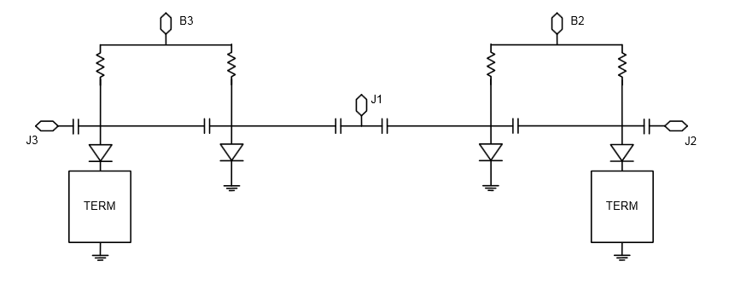
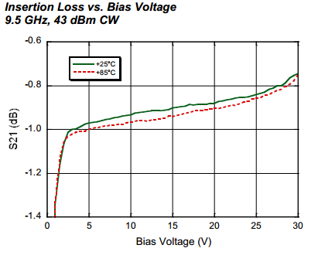
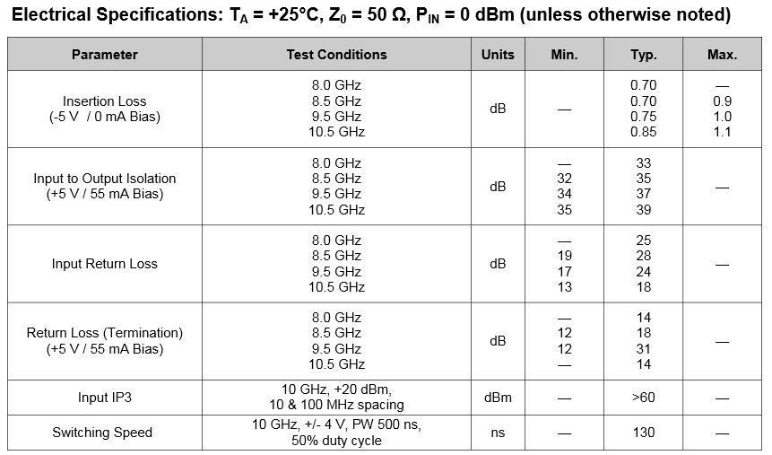
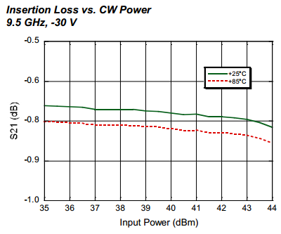
HMICTM SP2T 6-14 GHz (Terminated SPDT) MASW-010647
X-Band Terminated SPDT switch
Wire-Bondable Bare Die
Low Insertion Loss/ High Isolation
All Shunt Design; Integrated Bias Network
Glass Encapsulated Construction
Greater than 20 W CW Power Handling @ 85 °C
Silicon Nitride Passivation/Polymer Scratch Protection
RoHS Compliant
Notes:
Delete specs table?

Slide 40
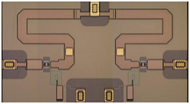
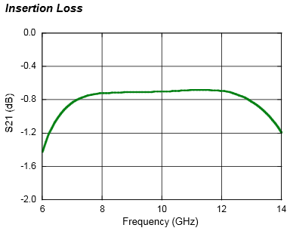
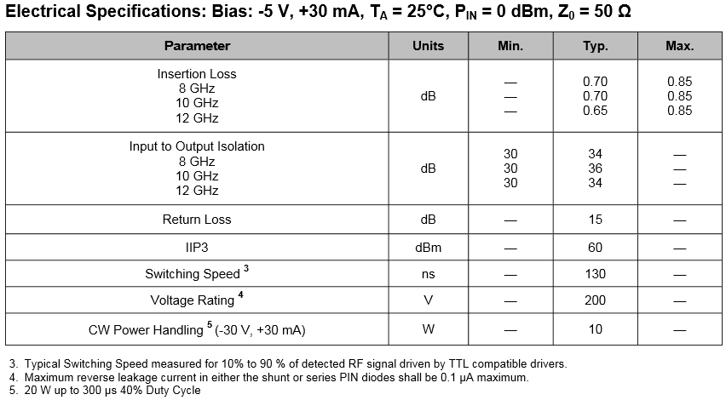
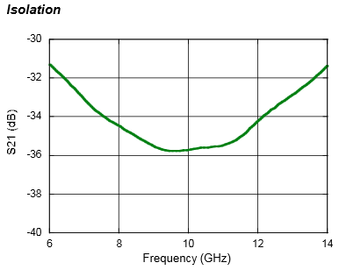
HMIC™ Si PIN SP2T 6-14 GHz MASW-011021
Specified from 8 GHz to 12 GHz ; Usable 6-14 GHz
Low Insertion Loss / High Isolation
All Shunt Design; Integrated Bias Network
Surface Mountable, Fully Monolithic Die
Glass Encapsulated Construction
20 W Pulsed Power Handling
Silicon Nitride Passivation / Polymer Scratch Protection
RoHS Compliant
Notes:
Delete Specs Table?

